Slide 1




Flipping the Script on Burger Flipping
Building Futures, Not Just Jobs
SUSAN CRYSTAL-MANSOUR, PH.D.
Vice President, Program Impact
ChooseRestaurants.org

Slide 2
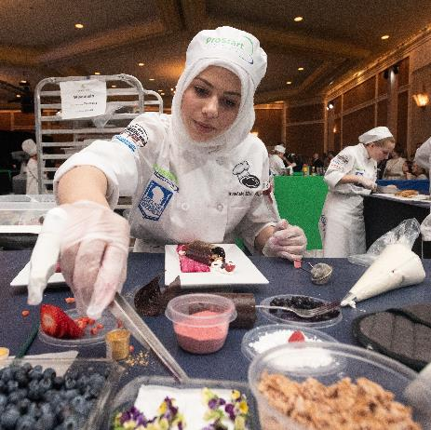
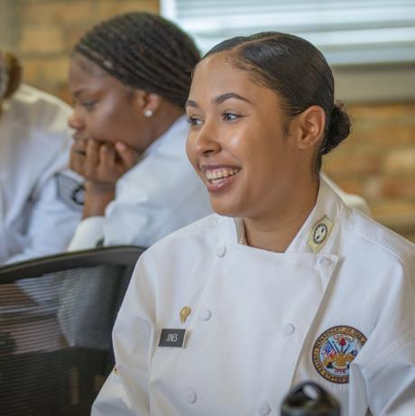

Myths About the Restaurant Industry

Slide 3
“In the restaurant industry, all you do is flip burgers.”
MYTH #1

Slide 4
Positions in a Restaurant
Baker | Banquet Manager | Bartender | Broiler Cook
Bus Person | Catering Manger | Counter Server | Line Supervisor
Dining Room Manager | Executive Chef | Expediter | Food and Beverage Director
Food Service Director | Fry/Sauté Cook | General Manager | Human Resources Manager
Kitchen Manager | Maître d’hotel | Pantry Cook | Pastry Chef
President/CEO | Public Relations Manager | Server | Soup and Sauce Cook
Sous Chef | Wine Steward | Marketing | Communications
Nutritionist | Dish Washer | Supply Chain Manager | Research & Development

Slide 5
“The restaurant industry is full of dead-end jobs.”
MYTH #2

Slide 6
Advancement
72% of restaurant/food service employees report receiving on the job training.
70% of restaurants/food service establishments report providing training to their employees at a minimum of every few months.
41% of salaried workers started off as hourly.
On average, between 20 - 25% of restaurant job openings were filled by employees being promoted.
90% of owner/operators worked their way up from entry level positions.

Slide 7
“You cannot earn a livable wage in the restaurant industry..”
MYTH #3

Slide 8
Salary DATA
 | Restaurant Manager | Shift/Crew Supervisor | Chef / Cook
BLS 2019 reported salary | $59,820 | $36,960 | $56,310
Reported pay raise last 12 months (%) - hourly | 72% | 69% | 63%
Reported pay raise last 12 months (%) - salary | 72% | 56% | 73%
Years with an employer | Percent earning minimum wage
Less than a year | 27
1-2 years | 18
2-5 years | 12
5-10+ years | 5

Slide 9
Middle Class Job Growth

Slide 10
Are there really jobs out there?
1,576,700 Job Postings in the last year
196,745 postings in the last month
December 2020: 685,000 open jobs

Slide 11







Our mission
National Restaurant Association Educational Foundation (NRAEF) is dedicated to:
Training,
Education,
Financial resources, and
Career development
Our mission is to Attract, Empower and Advance the industry’s next generation of talent.

Slide 12
WE FEED DREAMS + BUILD FUTURES
ATTRACT
people from all backgrounds
to jobs and careers in restaurants
EMPOWER
people to explore and chart their own path to success
ADVANCE
people across our industry
and change lives

Slide 13
SECTOR STRATEGIES
Sector Strategies are partnerships between employers, government, education, training, economic development, labor and community organizations to focus on workforce needs of an industry within a regional labor market.
They are industry-driven approaches that shrink the gap between the demand for and supply of labor.
They align education, training, and related services with the skills and competencies required by employers.
They are policies and investments that support the development of local sector partnerships.

Slide 14
INDUSTRY SECTOR PARTNERSHIPS
Community Based Organizations
Restaurant Ready
HOPES
K-12
ProStart
Post-Secondary Education & Training
Apprenticeship
Military
Scholarships / Grants
Government Organizations
HOPES
Restaurant Ready
State Restaurant Associations
Business
&
Industry
NRAEF –
Convener

Slide 15








OUR PURPOSE IS TO CREATE…
OPPORTUNITY
ChooseRestaurants.org
| 15

Slide 16
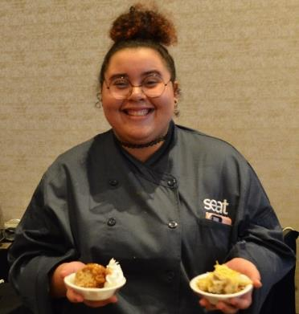



Restaurant Ready
The NRAEF partners with community-based organizations
and local hospitality employers
Individuals looking to enter or reenter the workforce
Focuses on six core competencies—first job and life skills
Provides support/case management along with job readiness
ChooseRestaurants.org
| 16

Slide 17




USDOL REENTRY GRANT
H O
P
E
S
Hospitality Opportunities
for People (Re)Entering Society – HOPES Program
Creating pathways from the justice system to jobs in restaurants and hospitality
Connecting DOCs, CBOs and SRAs
Employment, career pathways, and support are the key factors to reducing recidivism
ChooseRestaurants.org
| 17

Slide 18

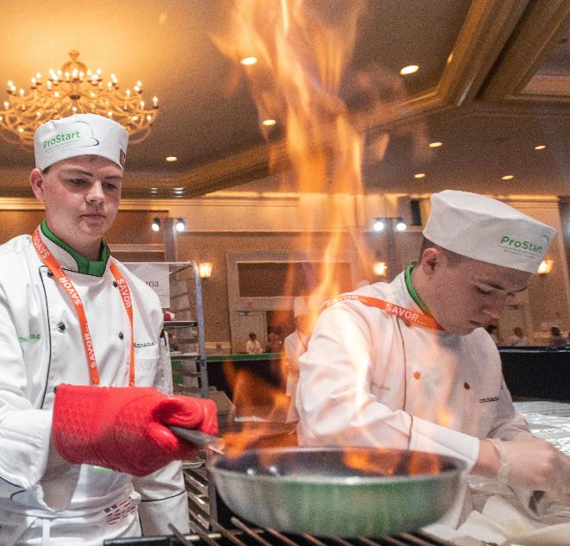


ProStart
Nationally recognized career and technical education program; culinary arts and restaurant management
1,500 schools in all 50 states and US Territories
Graduates attain certificate upon completion of two exams and 400 on-the-job hours
Articulation Agreements with Post-Secondary institutions
Written into apprenticeship standards
150,000
HIGH SCHOOLS
ENROLLED ANNUALLY
ChooseRestaurants.org
| 18

Slide 19
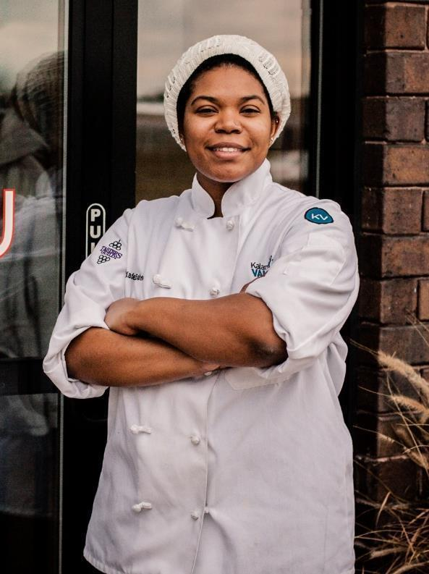

Apprenticeship
USDOL registered apprenticeship program
Partnership with American Hotel and Lodging Association
Employer based, competency, apprenticeships; Restaurant Manager, Lodging Manager, Line Cook
Combines on-the-job training with classroom instruction
80%
RETENTION RATE
2,300+
APPRENTICES
ChooseRestaurants.org
| 19

Slide 20
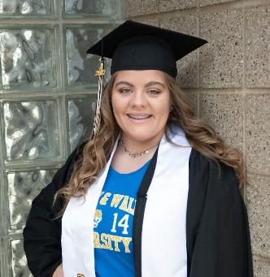



Scholarships
More than $850K awarded annually
Post-secondary education
Professional development
$850K
Awarded Annually
NPSI Scholarship Recipients
ChooseRestaurants.org
| 20

Slide 21
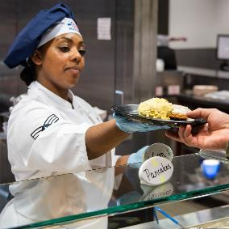
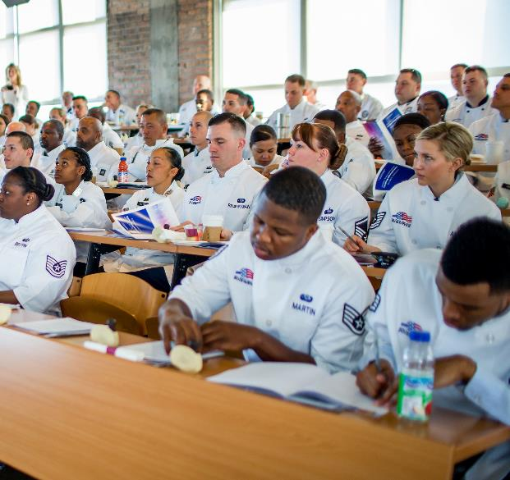


Offer advanced training in culinary arts and restaurant management
Celebrating excellence in Military Foodservice
Bringing industry insight and opportunity to the military
Industry shadowing and bridging
Facilitating Veteran hiring
Apprenticeship
Understanding career needs of military spouses and families
Military
250,000
Veterans working
in the restaurant
industry

Slide 22
What is our opportunity together?

Slide 23
Our Employees are Students
27% of industry employees are students.
83% do not have a post-secondary degree.
Enrolled Education | Manager | Supervisor | Chef/Cook | Wait Staff | Bartender | Crew | Dishwasher
 | 8% | 21% | 15% | 33% | 21% | 37% | 29%
Of Those Enrolled
Community College | 21% | 31% | 15% | 33% | 20% | 32% | 38%
Four year program | 49% | 36% | 25% | 41% | 64% | 37% | 12%

Slide 24
Eco System of Community Colleges, workforce development, apprenticeship
ATTRACTION
Ready to Work / Workforce Development
Entry Level Position
ENGAGEMENT
Post-Secondary Classes
Apprenticeship
ADVANCEMENT
Post-Secondary Degree
Apprenticeship

Slide 25
Our Programs are Collaboratives
Align to Industry Informed Competencies
Provide classroom training
Connect to mentorship
Develop articulation agreements
Facilitate continued education and degree attainment
Communicate the opportunities of the industry
Link programs to employers and employers to apprenticeship

Slide 26

Q&A
ChooseRestaurants.org
| 26

